Slide 1
COMP0005 – ALGORITHMS 2.2 Merge Sort
Prof Licia Capra
Dept of Computer Science

Slide 2
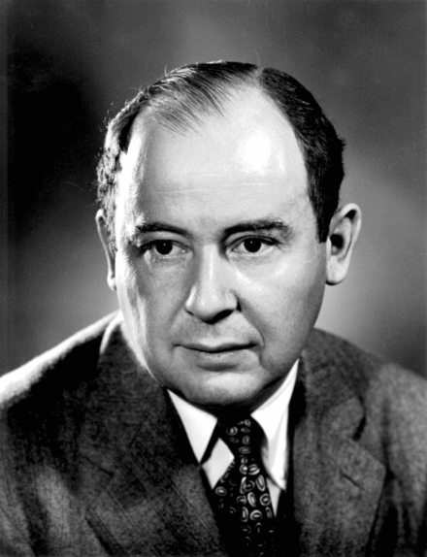
CONTENT
Elementary Sorts
MergeSort
QuickSort
HeapSort
John von Neumann

Slide 3
Merge sort
Key idea
Divide an array in two halves
Sort each half separately
Merge the two halves
Input array
M | E | R | G | E | S | O | R | T | E | X | A | M | P | L | E
Sort left half
E | E | G | M | O | R | R | S | T | E | X | A | M | P | L | E
Sort right half
E | E | G | M | O | R | R | S | A | E | E | L | M | P | T | X
Merge results
A | E | E | E | E | G | L | M | M | O | P | R | R | S | T | X

Slide 4
Merge sort
Key idea – Divide and conquer
Divide an array in two halves (split the problem)
Sort each half separately (solve smaller instances of the problem)
Merge the two halves (recombine the solutions of the smaller problems into the solution of the larger problem)
Input array
M | E | R | G | E | S | O | R | T | E | X | A | M | P | L | E
Sort left half
E | E | G | M | O | R | R | S | T | E | X | A | M | P | L | E
Sort right half
E | E | G | M | O | R | R | S | A | E | E | L | M | P | T | X
Merge results
A | E | E | E | E | G | L | M | M | O | P | R | R | S | T | X

Slide 5
Merge sort
Example – merge step
Given two sorted subarrays a[lo] to a[mid] and a[mid+1] to a[hi], compute sorted subarray a[lo] to a[hi].
lo
mid mid+1
hi
a[]
E | E | G | M | O | R | R | S | A | E | E | L | M | P | T | X
sorted
sorted

Slide 6
Merge sort
Example – merge step
Given two sorted subarrays a[lo] to a[mid] and a[mid+1] to a[hi], compute sorted subarray a[lo] to a[hi].
k
a[]
E | E | G | M | O | R | R | S | A | E | E | L | M | P | T | X
aux[]
E | E | G | M | O | R | R | S | A | E | E | L | M | P | T | X
i
j

Slide 7
Merge sort
Example – merge step
Given two sorted subarrays a[lo] to a[mid] and a[mid+1] to a[hi], compute sorted subarray a[lo] to a[hi].
k
a[]
A | E | G | M | O | R | R | S | A | E | E | L | M | P | T | X
aux[]
E | E | G | M | O | R | R | S | A | E | E | L | M | P | T | X
i
j

Slide 8
Merge sort
Example – merge step
Given two sorted subarrays a[lo] to a[mid] and a[mid+1] to a[hi], compute sorted subarray a[lo] to a[hi].
k
a[]
A | E | G | M | O | R | R | S | A | E | E | L | M | P | T | X
aux[]
E | E | G | M | O | R | R | S | A | E | E | L | M | P | T | X
i
j

Slide 9
Merge sort
Example – merge step
Given two sorted subarrays a[lo] to a[mid] and a[mid+1] to a[hi], compute sorted subarray a[lo] to a[hi].
k
a[]
A | E | E | M | O | R | R | S | A | E | E | L | M | P | T | X
aux[]
E | E | G | M | O | R | R | S | A | E | E | L | M | P | T | X
i
j

Slide 10
Merge sort
Example – merge step
Given two sorted subarrays a[lo] to a[mid] and a[mid+1] to a[hi], compute sorted subarray a[lo] to a[hi].
k
a[]
A | E | E | E | O | R | R | S | A | E | E | L | M | P | T | X
aux[]
E | E | G | M | O | R | R | S | A | E | E | L | M | P | T | X
i
j

Slide 11
Merge sort
Example – merge step
Given two sorted subarrays a[lo] to a[mid] and a[mid+1] to a[hi], compute sorted subarray a[lo] to a[hi].
k
a[]
A | E | E | E | E | R | R | S | A | E | E | L | M | P | T | X
aux[]
E | E | G | M | O | R | R | S | A | E | E | L | M | P | T | X
i
j

Slide 12
Merge sort
Example – merge step
Given two sorted subarrays a[lo] to a[mid] and a[mid+1] to a[hi], compute sorted subarray a[lo] to a[hi].
k
a[]
A | E | E | E | E | G | R | S | A | E | E | L | M | P | T | X
aux[]
E | E | G | M | O | R | R | S | A | E | E | L | M | P | T | X
i
j

Slide 13
Merge sort
Example – merge step
Given two sorted subarrays a[lo] to a[mid] and a[mid+1] to a[hi], compute sorted subarray a[lo] to a[hi].
k
a[]
A | E | E | E | E | G | L | S | A | E | E | L | M | P | T | X
aux[]
E | E | G | M | O | R | R | S | A | E | E | L | M | P | T | X
i
j

Slide 14
Merge sort
Example – merge step
Given two sorted subarrays a[lo] to a[mid] and a[mid+1] to a[hi], compute sorted subarray a[lo] to a[hi].
k
a[]
A | E | E | E | E | G | L | M | A | E | E | L | M | P | T | X
aux[]
E | E | G | M | O | R | R | S | A | E | E | L | M | P | T | X
i
j

Slide 15
Merge sort
Example – merge step
Given two sorted subarrays a[lo] to a[mid] and a[mid+1] to a[hi], compute sorted subarray a[lo] to a[hi].
k
a[]
A | E | E | E | E | G | L | M | M | E | E | L | M | P | T | X
aux[]
E | E | G | M | O | R | R | S | A | E | E | L | M | P | T | X
i
j

Slide 16
Merge sort
Example – merge step
Given two sorted subarrays a[lo] to a[mid] and a[mid+1] to a[hi], compute sorted subarray a[lo] to a[hi].
k
a[]
A | E | E | E | E | G | L | M | M | O | E | L | M | P | T | X
aux[]
E | E | G | M | O | R | R | S | A | E | E | L | M | P | T | X
i
j

Slide 17
Merge sort
Example – merge step
Given two sorted subarrays a[lo] to a[mid] and a[mid+1] to a[hi], compute sorted subarray a[lo] to a[hi].
k
a[]
A | E | E | E | E | G | L | M | M | O | P | L | M | P | T | X
aux[]
E | E | G | M | O | R | R | S | A | E | E | L | M | P | T | X
i
j

Slide 18
Merge sort
Example – merge step
Given two sorted subarrays a[lo] to a[mid] and a[mid+1] to a[hi], compute sorted subarray a[lo] to a[hi].
k
a[]
A | E | E | E | E | G | L | M | M | O | P | R | M | P | T | X
aux[]
E | E | G | M | O | R | R | S | A | E | E | L | M | P | T | X
i
j

Slide 19
Merge sort
Example – merge step
Given two sorted subarrays a[lo] to a[mid] and a[mid+1] to a[hi], compute sorted subarray a[lo] to a[hi].
k
a[]
A | E | E | E | E | G | L | M | M | O | P | R | R | P | T | X
aux[]
E | E | G | M | O | R | R | S | A | E | E | L | M | P | T | X
i
j

Slide 20
Merge sort
Example – merge step
Given two sorted subarrays a[lo] to a[mid] and a[mid+1] to a[hi], compute sorted subarray a[lo] to a[hi].
k
a[]
A | E | E | E | E | G | L | M | M | O | P | R | R | S | T | X
aux[]
E | E | G | M | O | R | R | S | A | E | E | L | M | P | T | X
i
j

Slide 21
Merge sort
Example – merge step
Given two sorted subarrays a[lo] to a[mid] and a[mid+1] to a[hi], compute sorted subarray a[lo] to a[hi].
k
a[]
A | E | E | E | E | G | L | M | M | O | P | R | R | S | T | X
aux[]
E | E | G | M | O | R | R | S | A | E | E | L | M | P | T | X
i
j

Slide 22
Merge sort
Example – merge step
Given two sorted subarrays a[lo] to a[mid] and a[mid+1] to a[hi], compute sorted subarray a[lo] to a[hi].
lo
hi
a[]
A | E | E | E | E | G | L | M | M | O | P | R | R | S | T | X
sorted

Slide 23
Merge sort
Pseudocode – merge step
Pre-condition: a[lo,mid] is sorted
Pre-condition: a[mid+1,hi] is sorted
Postcondition: a[lo,hi] is sorted
merge(a[], aux[], lo, mid, hi):
for (k = lo; k <= hi; k++)
aux[k] = a[k];
i = lo;
j = mid+1;
for (k = lo; k <= hi; k++)
if (i > mid) a[k] = aux[j]; j++;
else if (j > hi) a[k] = aux[i]; i++;
else if (aux[j] < aux[i]) a[k] = aux[j]; j++;
else a[k] = aux[i]; i++;

Slide 24
Merge sort
Pseudocode – divide & sort steps
sort(a[], aux[], lo, hi):
if (hi <= lo) return;
mid = lo + (hi - lo) / 2;
sort(a, aux, lo, mid);
sort(a, aux, mid+1, hi);
merge(a, aux, lo, mid, hi);
sort(a, aux, 0, a.length-1)

Slide 25
Merge sort
0 | 1 | 2 | 3 | 4 | 5 | 6
Pseudocode – divide & sort steps
a[]
E | X | A | M | P | L | E
sort(a[], aux[], lo, hi):
if (hi <= lo) return;
mid = lo + (hi - lo) / 2;
sort(a, aux, lo, mid);
sort(a, aux, mid+1, hi);
merge(a, aux, lo, mid, hi);
sort(0,6)
sort(0,3)
sort(0,1)
sort(0,0)
sort(1,1)
merge(0,1)
sort(2,3)
sort(2,2)
sort(3,3)
merge(2,3)
merge(0,3)
sort(a, aux, 0, 6)
sort(4,6)
sort(4,5)
sort(4,4)
sort(5,5)
merge(4,5)
sort(6,6)
merge(4,6)
merge(0,6)

Slide 26
Merge sort
Practical improvements
Stop if already sorted
sort(a[], aux[], lo, hi):
if (hi <= lo) return;
mid = lo + (hi - lo) / 2;
sort(a, aux, lo, mid);
sort(a, aux, mid+1, hi);
if (a[mid] <= a[mid+1]) return;
merge(a, aux, lo, mid, hi);

Slide 27
Merge sort
Practical improvements
Avoid copying to the auxiliary array
merge(a[], aux[], lo, mid, hi):
for (k = lo; k <= hi; k++)
aux[k] = a[k];
i = lo;
j = mid+1;
for (k = lo; k <= hi; k++)
if (i > mid) aux[k] = a[j]; j++;
else if (j > hi) aux[k] = a[i]; i++;
else if (a[j] < a[i]) aux[k] = a[j]; j++;
else aux[k] = a[i]; i++;
sort(a[], aux[], lo, hi):
if (hi <= lo) return;
mid = lo + (hi - lo) / 2;
sort(aux, a, lo, mid);
sort(aux, a, mid+1, hi);
merge(a, aux, lo, mid, hi);

Slide 28
Merge sort
Analysis
Empirical
Laptop: 10⁸ compares/second.
Supercomputer: 10¹² compares/second.
 | Insertion Sort |  |  | Merge Sort
computer | ~k | ~M | ~G | ~k | ~M | ~G
home | instant | hours | years | instant | seconds | minutes
super | instant | seconds | weeks | instant | instant | instant

Slide 29
Merge sort
Analysis
Mathematical
Proposition: merge sort uses at most N lg N compare operations and 6N lg N array access operations to sort any array of size N
Intuition (case of N being power of 2):
ms(N)
N
2(N/2)
4(N/4)
…
2^{k}(N/2^{k})
…
N/2(2)
= N
= N
= N
…
= N
…
= N
ms(N/2)
ms(N/2)
ms(N/4)
ms(N/4)
ms(N/4)
ms(N/4)
lgN
ms(N/2^{k})
ms(2)
ms(2)
ms(2)
ms(2)
ms(2)
ms(2)
ms(2)
ms(2)

Slide 30
MERGE SORT
Analysis: merge sort is an optimal algorithm in terms of number of operations, since its cost (~N log N) is a proven limit (lower bound) for all compare-based sorting algorithms
Memory: merge sort uses extra space proportional to N
A sorting algorithm is in-place if it uses ≤ c log N extra memory
Selection and insertion sort are in-place sorting algorithms

Slide 31
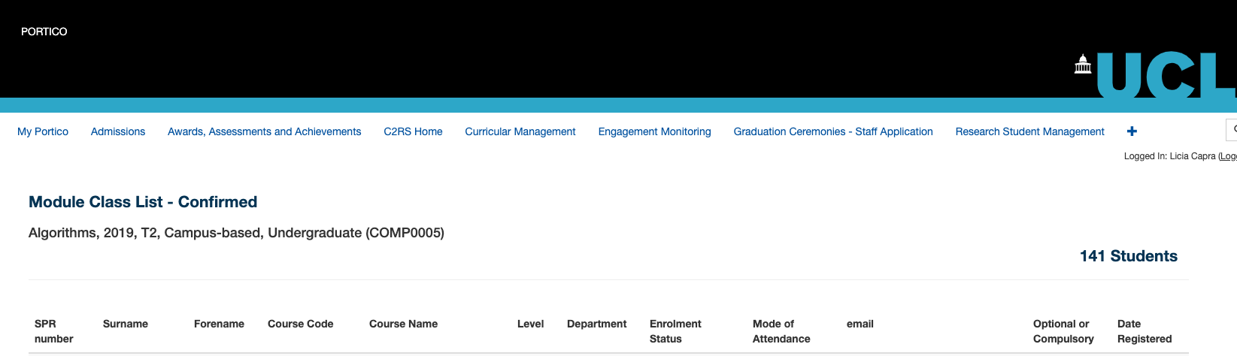
MERGE SORT
A sorting algorithm is said to be stable if two items with equal keys appear in the same order in the sorted output as they appear in the input array

Slide 32
MERGE SORT
A sorting algorithm is said to be stable if two items with equal keys appear in the same order in the sorted output as they appear in the input array
Surname | Course | …
Smith | BSc
Taylor | BSc
Davies | MEng
Jones | MEng
Williams | MEng
Surname | Course | …
Smith | BSc
Jones | MEng
Williams | MEng
Taylor | BSc
Davies | MEng
Surname | Course | …
Davies | MEng
Jones | MEng
Smith | BSc
Taylor | BSc
Williams | MEng
Surname | Course | …
Smith | BSc
Taylor | BSc
Williams | MEng
Jones | MEng
Davies | MEng

Slide 33
MERGE SORT
A sorting algorithm is said to be stable if two items with equal keys appear in the same order in the sorted output as they appear in the input array
Stable sorts: insertion and merge
insertion sort:
for(j=i; j>0; j--)
if (a[j] < a[j-1])
swap(a[j], a[j-1])
merge sort:
[…]
for (k = lo; k <= hi; k++)
if (i > mid) a[k] = aux[j]; j++;
else if (j > hi) a[k] = aux[i]; i++;
else if (aux[j] < aux[i]) a[k] = aux[j]; j++;
else a[k] = aux[i]; i++;

Slide 34
MERGE SORT
A sorting algorithm is said to be stable if two items with equal keys appear in the same order in the sorted output as they appear in the input array
Stable sorts: insertion and merge
Non-stable sorts: selection
0 | 1 | 2 | 3
selection sort:
min=i
for(j=i+1; j<N; j++)
if (a[j] < a[min]) min = j
swap(a[i], a[min])
i=0, min=3
MEng1 | MEng2 | MEng3 | BSc1
i=1, min=1
BSc1 | MEng2 | MEng3 | MEng1
i=2, min=2
BSc1 | MEng2 | MEng3 | MEng1
i=3, min=3
BSc1 | MEng2 | MEng3 | MEng1
BSc1 | MEng2 | MEng3 | MEng1

Slide 35
CONTENT – recap
Elementary Sorts
MergeSort
QuickSort
HeapSort

